Slide 1
Introduction to Statistical Methods
Team ISM

Slide 2
Overview of the course
& Basic of Statistics (CS -1)
23rd and 24th November 2024

Slide 3

IMP Note to Self

Slide 4
Overview of the course
M 1 : Basic Probability & Statistics
M 2 : Conditional Probability & Bayes’ theorem
M 3 : Probability Distributions
M 4 : Hypothesis Testing
M 5 : Prediction & Forecasting
M 6 : Prediction & Forecasting Gaussian Mixture model &
Expectation Maximization

Slide 5
TEXT BOOKS
T1 : Statistics for Data Scientists, An introduction to Probability,
Statistics and Data Analysis, Maurits Kaptein et al,Springer 2022
T2 : Probability and Statistics for Engineering and Sciences,
8th Edition, Jay L Devore, Cengage Learning
T3 : Introduction to Time Series and Forecasting, Second Edition,
Peter J Brockwell, Richard A Davis, Springer.

Slide 6
Evaluation Components
No | Name | Type | Weight
EC-1(a) | Quizzes – 1 & 2 | Online | 10%
EC-1(b) | Assignments – 1 & 2 | Online | 20%
EC-2 | Mid-Semester Test | Closed Book | 30%
EC-3 | Comprehensive Exam | Open Book | 40%

Slide 7
Module 1: (Basic Probability & Statistics)
Contact Session | List of Topic Title | Reference
CS - 1 | Measures of Central Tendency & Measures of Variability, Data – Symmetric & Asymmetric, outlier detection, 5 point summary, Introduction to probability(Session-2) | T1 & T2

Slide 8
“Statistical thinking will be one day as necessary for efficient citizenship as the ability to read and write”
H G Wells

Slide 9
Statistics
Statistics may be defined as science that is employed to
Collect the data
Present and organize the data in a systematic manner
Analyse the data
Infer about the data
Take decision from the data.
In other words, Statistics can also be defined as numerical data with a view to analyse it.

Slide 10
Why Study Statistics?
Answers provided by statistical approaches can provide the basis for making decisions or choosing actions.
When information is sought, statistical ideas suggest a typical collection process with four crucial steps.
Set clearly defined goals for the investigations.
Make a plan of what data to collect and how to collect it.
Apply appropriate statistical methods to extract information from the data.
Interpret the information and draw conclusions.

Slide 11
Current Day Statistics!
Descriptive Statistics
Presentation of data in tables and charts, and summarization by graphs and numerical descriptions.
Statistical Inference
Generalization Based on Sample Data.

Slide 12
Current Day Statistics!
Population Vs Sample
Selection of Sample
Avoid biasness
Keeping Objective in mind
Use Random numbers

Slide 13
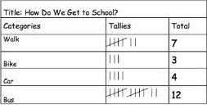
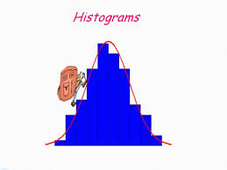
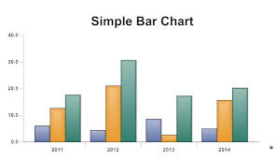
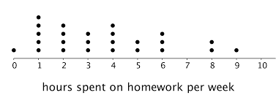
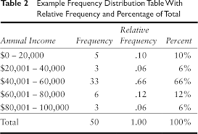
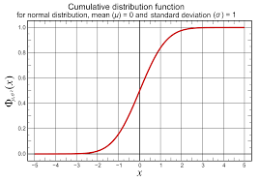
Representation of Data (Graphical)
Statistical data obtained from the surveys, experiments, etc. are useless until they are arranged in proper and required form.
Tally Table
Dot Diagram.
Bar Chart.
Frequency Distributions.
Histograms.
Cumulative Distribution.

Slide 14
Types of Variables
Data
Examples:
Marital Status
Political Party
Eye Color
(Defined categories)
Categorical
Numerical
Discrete
Continuous
Examples:
Number of Children
Defects per hour
(Counted items)
Examples:
Weight
Voltage
(Measured characteristics)

Slide 15
Levels of Data Measurement
Nominal — Lowest level of measurement
Ordinal
Interval
Ratio — Highest level of measurement

Slide 16

Nominal
A nominal scale classifies data into distinct categories in which no ranking is implied
Example : Gender, Marital Status, voting to different party

Slide 17
Ordinal scale
An ordinal scale classifies data into distinct categories in which ranking is implied
Example:
Product satisfaction: Satisfied, Neutral, Unsatisfied
Faculty rank: Professor, Associate Professor, Assistant Professor
Student Grades: A, B, C, D, F
Medals won: Gold, Silver, Bronze

Slide 18
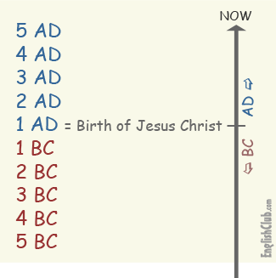
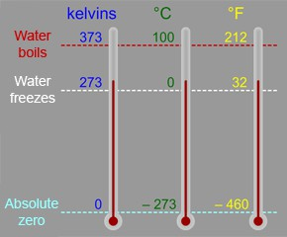
Interval scale
An interval scale is an ordered scale in which the difference between measurements is a meaningful quantity but the measurements do not have a true zero point.
Example
Temperature in Fahrenheit and Celsius
Months of the Year: there’s no month called zero and we can’t say January is twice as much as June.

Slide 19
Ratio scale
A ratio scale is an ordered scale in which the difference between the measurements is a meaningful quantity and the measurements have a true zero point.
Example
Weight
Age
Salary

Slide 20
Usage Potential of Various Levels of Data
Ratio
Interval
Ordinal
Nominal

Slide 21
Impact of choice of measurement scale
Data Level | Meaningful Operations | Statistical Methods
Nominal | Classifying and Counting | Nonparametric
Ordinal | All of the above plus Ranking | Nonparametric
Interval | All of the above plus Addition, Subtraction | Parametric
Ratio | All of the above plus multiplication and division | Parametric

Slide 22
Types of Variable
Qualitative (Categorical): express a qualitative attribute such as hair color, eye color, religion.
Quantitative(Numerical): measured in terms of numbers such as height, weight, number of people.
Nominal:
No ordering is possible such as hair color, eye color, religion.
Ordinal:
Ordering is possible such as health, which can take values such as poor, reasonable, good, or excellent.
Discrete: countable and have a finite number of possibilities such as number of people
Continuous: not countable and have an infinite number of possibilities such as height
INTERVAL: ratio of values of variable do not have any meaning and it does not have an inherently defined zero value such as temperature
RATIO: ratio of values of variable have meaning and it have an inherently defined zero value such as length

Slide 23
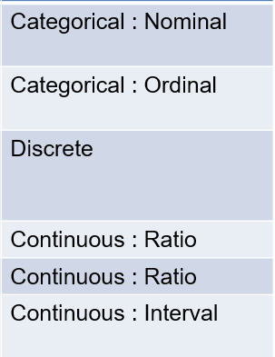
Example
Question | Type of Variable
Types of vehicle owned Two wheeler, four wheeler
Product satisfaction Unsatisfied, neutral, fairly satisfied, satisfied
To how many magazines do you currently subscribed Zero, One, Two, Three, Four
How tall are you (in inches)
Weight (in Kilograms)
Temperature (in degrees Celsius or degrees Fahrenheit)

Slide 24
Measures of Central Tendency
Measure of central tendency provides a very convenient way of describing a set of scores with a single number that describes the PERFORMANCE of the group.
Also defined as a single value that is used to describe the “center” of the data.
Three commonly used measures of central tendency:
Mean
Median
Mode

Slide 25
Mean
Also referred as the “arithmetic average”
The most commonly used measure of the center of data
Numbers that describe what is average or typical of the distribution
Computation of Sample Mean:
= Σ Y/ N = (Y₁ + Y₂ + Y₃ + … Y_{n}) / N where
“Y bar” equals the sum of all the scores, Y, divided by the number of scores, N.
Computation of the Mean for grouped Data
Where f Y = a score multiplied by its frequency

Slide 26
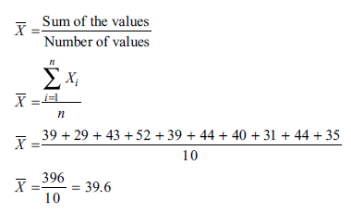
Mean: Ungrouped Data
Suppose you define the time to get ready as the time (rounded to the nearest minute) from when you get out of bed to when you leave your home. You collect the times shown below for 10 consecutive work days:
Day | 1 | 2 | 3 | 4 | 5 | 6 | 7 | 8 | 9 | 10
Time (min) | 39 | 29 | 43 | 52 | 39 | 44 | 40 | 31 | 44 | 35
The mean time is 39.6 minutes, computed as follows:

Slide 27
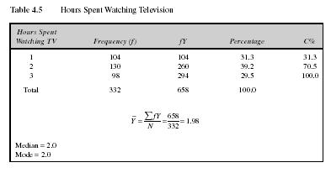
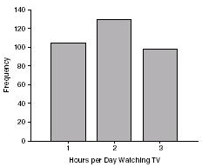
Mean: Grouped Scores
Data of Children watching TV in Bengaluru

Slide 28
Mean
Properties
It measures stability. Mean is the most stable among other measures of central tendency because every score contributes to the value of the mean.
It may easily affected by the extreme scores.
The sum of each score’s distance from the mean is zero.
It can be applied to interval level of measurement
It may not be an actual score in the distribution
It is very easy to compute.

Slide 29
Mean
When to Use the Mean
Other measures are to be computed such as standard deviation, coefficient of variation and skewness
Sampling stability is desired.

Slide 30
The Mode
The category or score with the largest frequency (or percentage) in the distribution.
The mode can be calculated for variables with levels of measurement that are: nominal, ordinal, or interval-ratio.
Example: A systems manager in charge of a company s network keeps track of the number of server failures that occur in a day. Compute the mode for the following data, which represents the number of server failures in a day for the past two weeks:.
1 3 0 3 26 2 7 4 0 2 3 3 6 3
Because 3 appears five times, more times than any other value, the mode is 3. Thus, the systems manager can say that the most common occurrence is having three server failures in a day.

Slide 31
Mode
Properties
It can be used when the data are qualitative as well as quantitative.
It may not be unique.
It is not affected by extreme values.
When to Use the Mode
When the data set is measured on a nominal scale

Slide 32
The Median
The score that divides the distribution into two equal parts, so that half the cases are above it and half below it.
You compute the median value by following one of two rules:
Rule 1 If there are an odd number of values in the data set, the median is the middle-ranked value.
Rule 2 If there are an even number of values in the data set, then the median is the average of the two middle ranked values.
The median is the middle score, or average of middle scores in a distribution.
Fifty percent (50%) lies below the median value and 50% lies above the median value.
It is also known as the middle score or the 50th percentile.

Slide 33
Median
Example-1: The three-year annualized returns for the seven small-cap growth funds with low risk are ranked from the smallest to the largest:
The Median is the 4th position value i.e. 22.4.
Example-2: Consider the time taken for reaching office from home in minutes arranged from lowest to highest
29 31 35 39 39 40 43 44 44 52
The number of observations are 10. Hence the median is the average of values at the 5th and 6th Position, i.e. average of 39 and 40 = 39.5
19.0 20.8 22.3 22.4 24.9 26.0 29.9

Slide 34
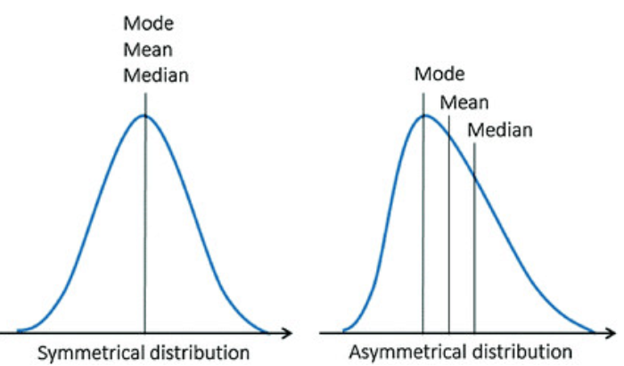
Data : Symmetrical and Asymmetrical
Central tendency Median is used for both Symmetrical and Asymmetrical data
While Mean or Mode or Median can be used as central tendency for Symmetrical data.

Slide 35
Shape of the distribution of data
Symmetrical : Mean is equal to median
Skewed
Negatively (Left): mean < median
Distributions with a left skew have long left tails;
Positively (Right) : mean > median
Distributions with a right skew have long right tails.
Bimodal : has two distinct modes
Multi-modal : has more than 2 distinct modes
Notes:
Draw Examples on the board

Slide 36
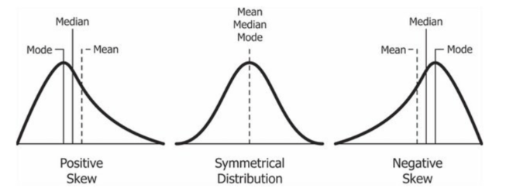
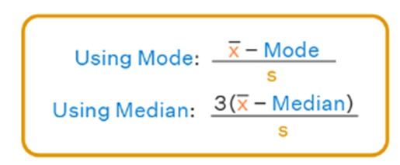
Types of Distribution
Note: In science, an empirical relationship is a relationship that is supported by experiment and observation but not necessarily supported by theory. For moderately skewed data (Skewness between -0.5 to 0.5) empirical relationship is
3Medain= Mode+2Mean

Slide 37
Why mean is not enough?
Sl. No. | X₁
1 | 2
2 | 8
3 | 5
4 | 3
5 | 7
6 | 8
7 | 5
8 | 2
9 | 5
Total | 45
Statistical measures | Group 1
Mean | 5
Median | 5
Mode | 5

Slide 38
Sl. No. | X₂
1 | 1
2 | 15
3 | 5
4 | 5
5 | 6
6 | 3
7 | 5
8 | 2
9 | 3
Total | 45
Statistical measures | Group 2
Mean | 5
Median | 5
Mode | 5

Slide 39
Sl. No. | X₁
1 | 2
2 | 8
3 | 5
4 | 3
5 | 7
6 | 8
7 | 5
8 | 2
9 | 5
Total | 45
X₂
1
15
5
5
6
3
5
2
3
45
Statistical measures | Group 1 & 2
Mean | 5
Median | 5
Mode | 5

Slide 40


Slide 41
Do we need any other measure?
Answer: Yes
Measures of variability
Three Measures of Variability:
The Range
The Variance
The Standard Deviations

Slide 42
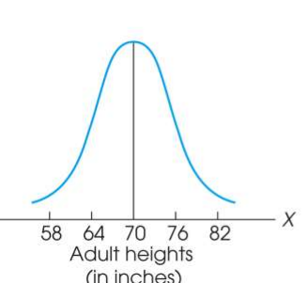
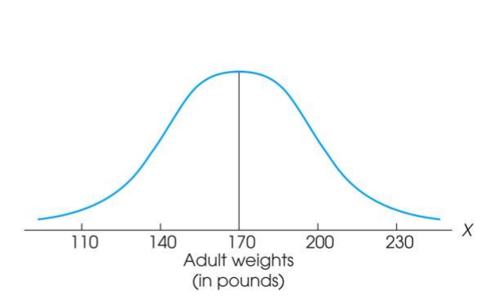
Measure of Variability
Variability can be defined several ways:
A quantitative distance measure based on the differences between scores
Describes distance of the spread of scores or distance of a score from the mean
Purposes of Measure of Variability:
Describe the distribution
Measure how well an individual score represents the distribution

Slide 43
The Ranges
The distance covered by the scores in a distribution – From smallest value to highest value
For continuous data, Real Limits are used
Based on two scores, not all the data – An imprecise, unreliable measure of variability
Range = URL for X_{max} - LRL for X_{min}
Example: For a set of scores: 7, 2, 7, 6, 5, 6, 2
Range = Highest Score minus Lowest score = 7 - 2 = 5

Slide 44
The Standard Deviation
Most common and most important measure of variability is the standard deviation
A measure of the standard, or average, distance from the mean
Describes whether the scores are clustered closely around the mean or are widely scattered
Calculation differs for population and samples
Variance is a necessary companion concept to standard deviation but not the same concept

Slide 45
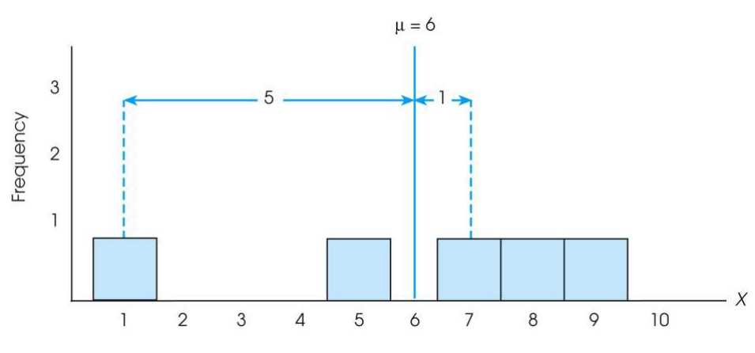
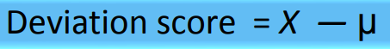
The Standard Deviation
Exercise : Find out the deviations of all the data points with the mean….and then find the ‘mean deviation’.

Slide 46

The Standard Deviation
Mean deviations will always be ‘zero’ !
(because Mean is a balance point)
Then, how do you find ‘Standard Deviation’ ?
Need a new strategy

Slide 47
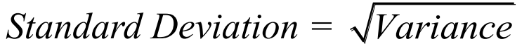
The Standard Deviation
New Strategy :
First square each deviation score
Then sum the Squared Deviations (SS)
Average the squared deviations
Mean Squared Deviation is known as “Variance”
Variability is now measured in squared units

Slide 48
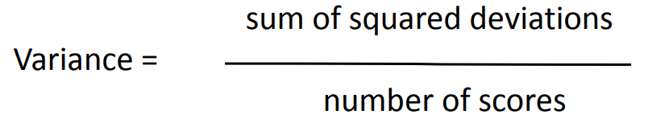
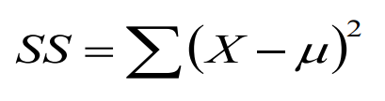
The Variance
Variance equals mean (average) squared deviation (distance) of the scores from the mean
where

Slide 49
The Population Variance
Population variance equals mean (average) squared deviation (distance) of the scores from the population mean
Variance is the average of squared deviations, so we identify population variance with a lowercase Greek letter sigma squared: σ²
Standard deviation is the square root of the variance, so we identify it with a lowercase Greek letter sigma: σ

Slide 50
Sl. No. | X₁
1 | 2
2 | 8
3 | 5
4 | 3
5 | 7
6 | 8
7 | 5
8 | 2
9 | 5
Total | 45
X₂
1
15
5
5
6
3
5
2
3
45
Statistical measures | Group 1 & 2
Mean | 5
Median | 5
Mode | 5

Slide 51
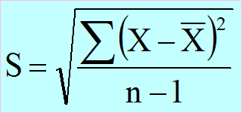
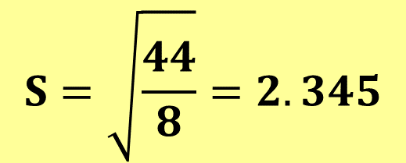
Sl. No. | X₁
1 | 2
2 | 8
3 | 5
4 | 3
5 | 7
6 | 8
7 | 5
8 | 2
9 | 5
Total | 45
$$S=\sqrt{\frac{44}{8}}=2.345$$

Slide 52
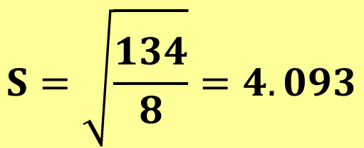
Sl. No. | X₂
1 | 1
2 | 15
3 | 5
4 | 5
5 | 6
6 | 3
7 | 5
8 | 2
9 | 3
Total | 45
$$S=\sqrt{\frac{134}{8}}=4.093$$

Slide 53
Learning Check
If all the scores in a data set are the same, the Standard Deviation is equal to 1.00
The standard deviation measures …
(1) Sum of squared deviation scores
(2) Standard distance of a score from the mean
(3) Average deviation of a score from the mean
(4) Sq. root of the average squared distance of a score from the mean
True / False ?
Select the correct option

Slide 54
Solution
If all the scores in a data set are the same, they are equal to the mean and hence the deviation from mean = 0 therefore, Standard Deviation is equal to zero
The standard deviation measures …
(1) Sum of squared deviation scores
(2) Standard distance of a score from the mean
(3) Average deviation of a score from the mean
(4) Sq. root of the average squared distance of a score from the mean
False

Slide 55
Standard Deviation and Variance for a Sample
Goal of inferential statistics:
Draw general conclusions about population based on limited information from a sample
Samples differ from the population
Samples have less variability
Computing the Variance and Standard Deviation in the same way as for a population would give a biased estimate of the population values

Slide 56
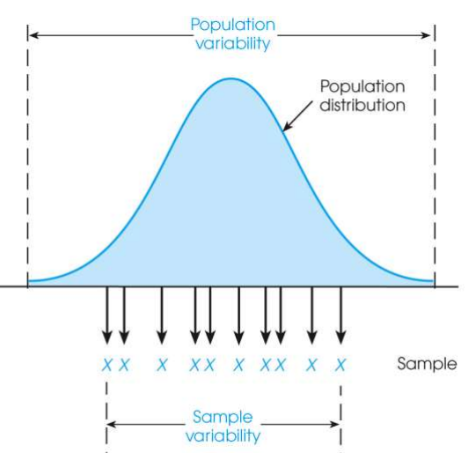
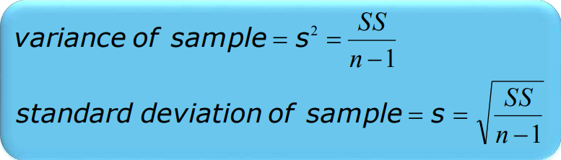
Sample Standard Deviation and Variance
Sum of Squares (SS) is computed as before
Formula for Variance has n-1 rather than N in the denominator
Notation uses s instead of σ

Slide 57
Degrees of Freedom
Population variance
Mean is known
Deviations are computed from a known mean
Sample variance as estimate of population
Population mean is unknown
Using sample mean restricts variability
Degrees of freedom
Number of scores in sample that are independent and free to vary
Degrees of freedom (df) = n – 1

Slide 58
Learning Check
Select the correct option
A sample of four scores has SS = 24. What is the variance?
The variance is 6
The variance is 7
The variance is 8
The variance is 12
A sample systematically has less variability than a population
The standard deviation is the distance from the Mean to the farthest point on the distribution curve
True / False ?
True / False ?

Slide 59
Solution
Select the correct option
A sample of four scores has SS = 24. What is the variance?
The variance is 6
The variance is 7
The variance is 8
The variance is 12
Extreme scores affect variability, but are less likely to be included in a sample
The standard deviation extends from the mean approximately halfway to the most extreme score
True
False

Slide 60
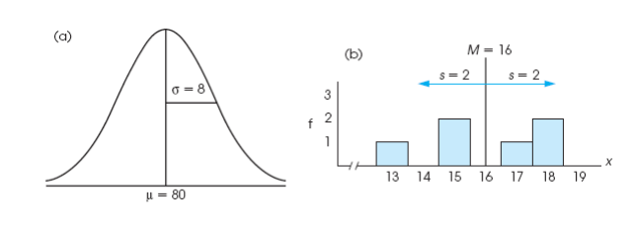
Descriptive Statistics
A standard deviation describes scores in terms of distance from the mean
Describe an entire distribution with just two numbers (M and s)
Reference to both allows reconstruction of the measurement scale from just these two numbers
Means and standard deviations together provide extremely useful descriptive statistics for characterizing distributions

Slide 61
Five point summary of Data
The five number summary of data includes 5 items:
Minimum.
Q1 (the first quartile, or the 25% mark).
Median.
Q3 (the third quartile, or the 75% mark).
Maximum.

Slide 62
Interquartile range (IQR)
It is measure of Variation
Also Known as Mid-spread : Spread in the Middle 50%
Difference Between Third & First Quartiles:
Not Affected by Extreme Values
Interquartile Range = IQR = Q₃ – Q₁
Data in Ordered Array: 11 12 13 16 16 17 17 18 21
1•(9 + 1)
Position of Q₁
=
= 2.50,
Q₁
=12.5
4
3•(9 + 1)
Position of Q₃
=
= 7.50,
Q₃
=17.5
4
Interquartile Range = IQR= Q₃ – Q₁ = 17.5 - 12.5 = 5

Slide 63
Box and Whisker plot
IQR = Q₃ – Q₁
Q₁-1.5 IQR
Q₃+1.5 IQR
Min
Max
Q₁
Q₂
Q₃
Outlier
Outlier

Slide 64
Box-and-Whisker plot
IQR = Q₃ – Q₁
Min
Q₁-1.5 IQR
Q₃+1.5 IQR
Max
Q₁
Q₂
Q₃
Q₃+3 IQR
Q₁-3 IQR
Major Outlier
Major Outlier

Slide 65
Potential outliers
The lower limit and upper limit of a data set are given by:
Lower limit = Q₁ - 1.5 x IQR
Upper limit = Q₃ + 1.5 x IQR
Data points that lie below the lower limit or above the upper limit are potential outliers.

Slide 66
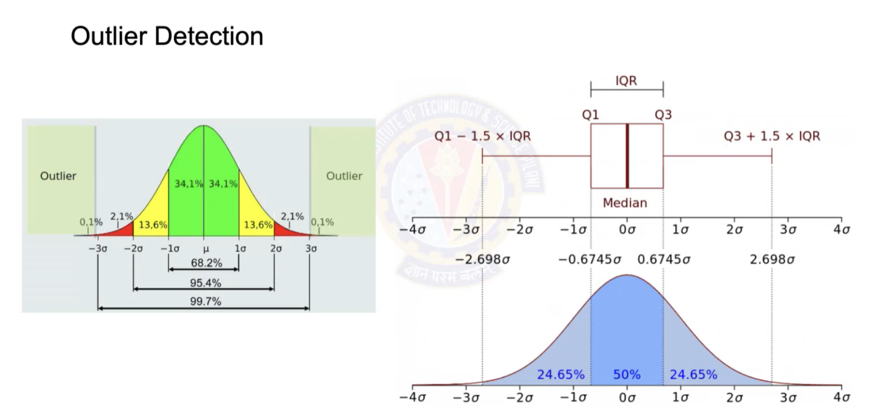

Slide 67
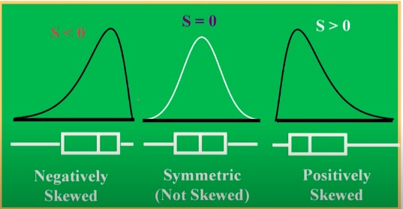
Box-and-Whisker plot: Skewness and coefficient of skewness

Slide 68
Glossary
Measures of Central Tendency:
Mean, Median, Mode
Measures of Variability: Range, Standard Deviation , Variance
Shape of the distribution
Five point summary
Outliers

Slide 69
Glossary
Measures of Central Tendency:
Mean, Median, Mode
Measures of Variability: Range, Standard Deviation , Variance
Shape of the distribution
Five point summary
Outliers

Slide 70
Practice Problems:
Q.1 A sample of 77 individuals working at a particular office was selected and the noise level (dBA) experienced by everyone is the following data:
55.3, 55.3, 55.3, 55.9, 55.9, 55.9, 55.9, 56.1, 56.1, 56.1, 56.1, 56.1, 56.1, 56.8, 56.8, 57.0, 57.0, 57.0, 57.8, 57.8, 57.8, 57.9, 57.9, 57.9, 58.8, 58.8, 58.8, 59.8, 59.8, 59.8, 62.2, 62.2, 63.8, 63.8, 63.8, 63.9, 63.9, 63.9, 64.7, 64.7, 64.7, 65.1, 65.1, 65.1, 65.3, 65.3, 65.3, 65.3, 67.4, 67.4, 67.4, 67.4, 68.7, 68.7, 68.7, 68.7, 69.0, 70.4, 70.4, 71.2, 71.2, 71.2, 73.0, 73.0, 73.1, 73.1, 74.6, 74.6, 74.6, 74.6, 79.3, 79.3, 79.3, 79.3, 83.0, 83.0, 83.0.
Find a) Arithmetic Mean, SD, variance, and IQR
b) Draw box and whisker plot
c) Comment on the outliers, if any.

Slide 71
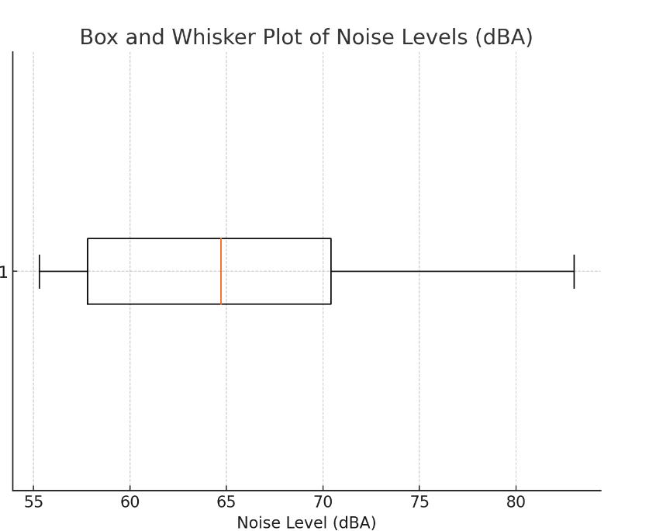
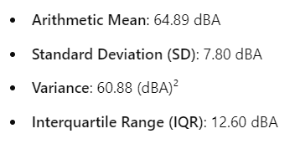
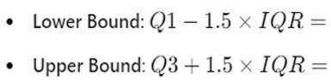
Solution:
b)
c)
Q1=57.8, Q3=70.4
38.9
89.3
Smallest value of data is 55.3 and largest value is 83, so no outliers in the dataset based on the IQR method

Slide 72
Practice Problems:
Q.2 The data given below is the total fat, in grams per serving, for a sample of 20 chicken sandwiches from fast-food chains.
7 8 4 5 16 20 20 24 19 30 23 30 25 19 29 29 30 30 40 56
a. Compute the mean, median, first quartile, and third quartile.
b. Compute the variance, standard deviation, range, interquartile range, Are there any outliers? Explain.
c. Are the data skewed? If so, how?
d. Based on the results of (a) through (c), what conclusions can you reach concerning the total fat of chicken sandwiches?

Slide 73
Practice Problems:
Q.3 The following data represent the battery life (in shots) for three pixel digital cameras:
300 180 85 170 380 460 260 35 380 120 110 240
List the Five-point summary.
Q.4 For the data set below:
a. Obtain and interpret the quartiles.
b. Determine and interpret the interquartile range.
c. Find and interpret the five-number(point) summary.
d. Identify potential outliers, if any.
e. Construct and interpret a boxplot.
82 | 45 | 64 | 80 | 82 | 74 | 79 | 80 | 80 | 78 | 80 | 80 | 48 | 73 | 80 | 79 | 81 | 70 | 78 | 73

Slide 74
Practice Problems:
Q.5 A bank branch located in a commercial place of a city has developed an improved process for serving customers during the noon-to-1:00 p.m. lunch period. The waiting time, in minutes (defined as the time the customer enters the line to when he or she reaches the teller window), of a sample of 15 customers during this hour is recorded over a period of one week. The results are: 4.21, 5.55, 3.02, 5.13, 4.77, 2.34, 3.54, 3.20, 4.50, 6.10, 0.38, 5.12, 6.46, 6.19, 3.79.
Another branch, located in a residential area, is also concerned with the noon-to-1 p.m. lunch hour. The waiting time, in of a sample of 15 customers during this hour is recorded over a period of one week. The results are listed below: 9.66, 5.90, 8.02, 5.79, 8.73, 3.82, 8.01, 8.35, 10.49, 6.68, 5.64, 4.08, 6.17, 9.91, 5.47.
a. List the five-number summaries of the waiting times at the two bank branches.
b. Construct box-and-whisker plots and describe the shape of the distribution of each for the two bank branches.
c. What similarities and differences are there in the distributions of the waiting time at the two bank branches?

Slide 75

IMP Note to Self

Slide 76
Thank You

